Slide 1

Underfitting & Overfitting in Machine Learning
Nachiketh

Slide 2
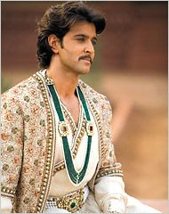
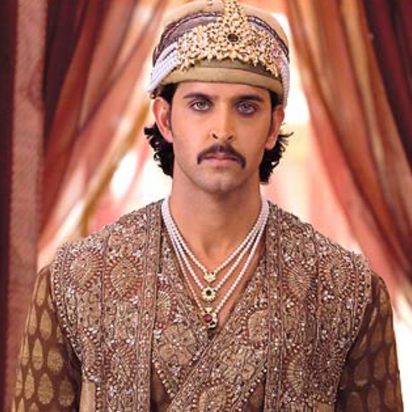
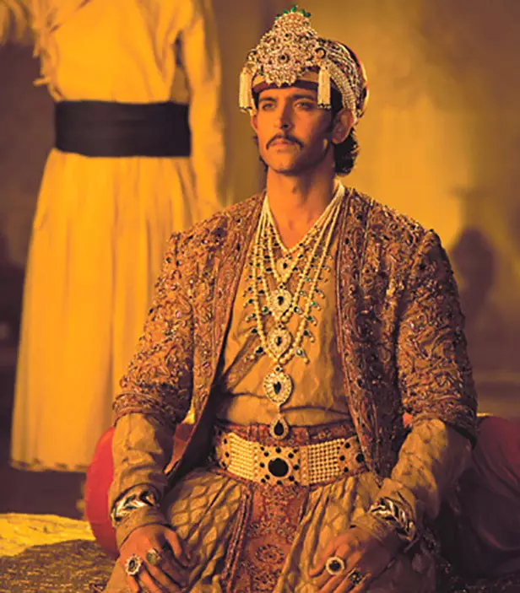
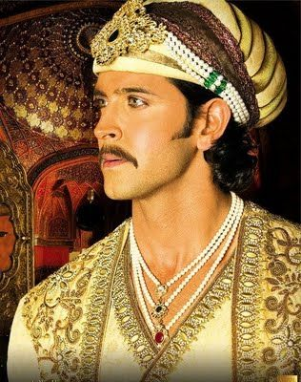


Example of Underfit
Model Prediction = 0

Slide 3
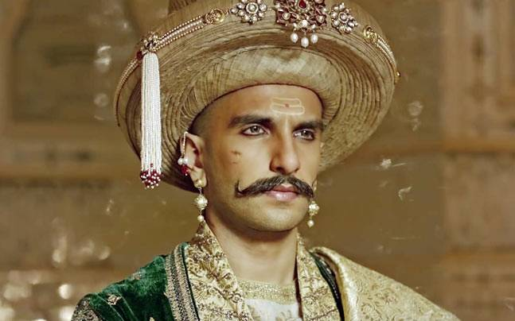
Example of Overfit
Model Prediction = 1

Slide 4
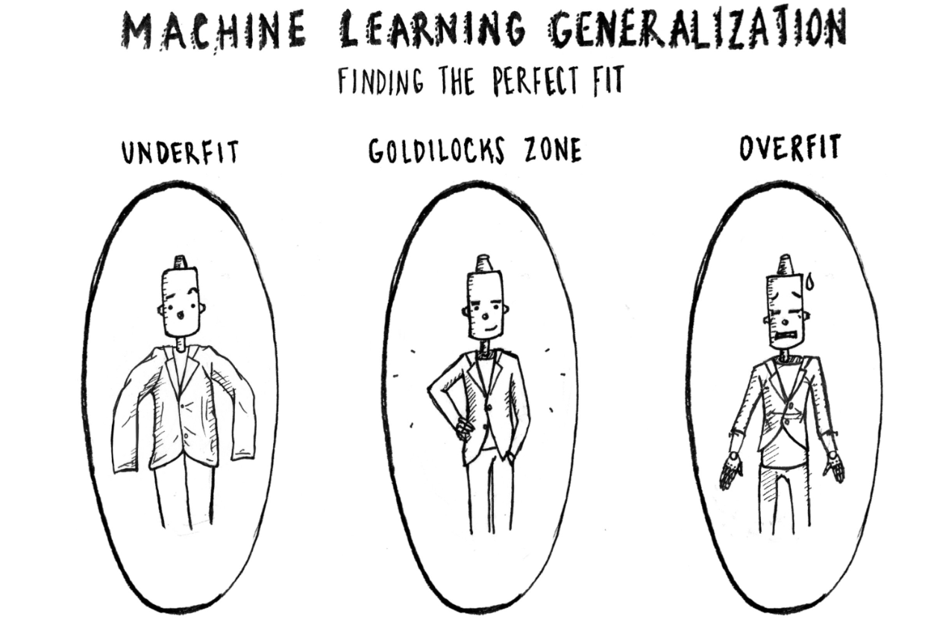
Generalization in Machine Learning
Generalization refers to how well the concepts learned by a machine learning model generalizes to specific examples or data not yet seen by the model.

Slide 5
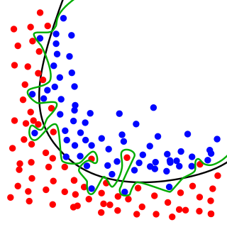
Goodness of fit
In statistics, The goodness of fit of a describes how well it fits for a set of observations

Slide 6
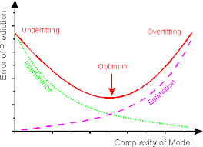
Overfit Vs Underfit
Underfitting occurs when a model is too simple — informed by too few features or regularized too much — which makes it inflexible in learning from the dataset.
Simple learners tend to have less variance in their predictions but more bias towards wrong outcomes. On the other hand, complex learners tend to have more variance in their predictions.

Slide 7
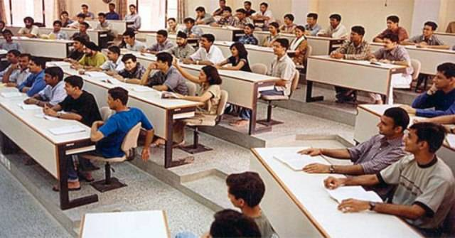

Analogy of Overfitting & Underfitting

Slide 8
Why it is important?
In machine learning, we can say that as too much focus on the training set (programmers) and learns complex relations which may not be valid in general for new data (test set).

Slide 9
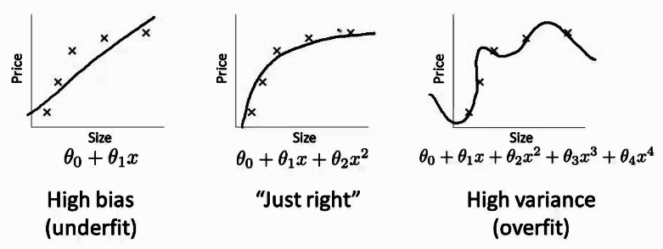
How to detect Underfitting/Overfitting
Bias-Variance Approach

Slide 10
How to detect Overfitting
To address this, we can split our initial dataset into separate training and test subsets. This method can approximate how well our model will perform on new data.
If our model does much better on the training set than on the test set, then we’re likely overfitting.
For example, it would be a big red flag if our model saw 95% accuracy on the training set but only 35% accuracy on the test set.

Slide 11
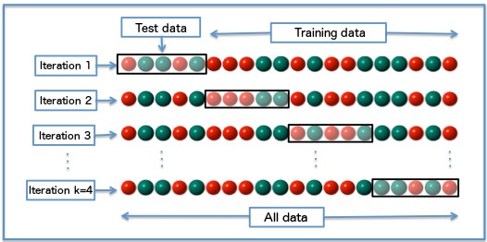
How to Prevent Overfitting?
Cross Validation:
A standard way to find out-of-sample prediction error is to use 5-fold cross-validation

Slide 12
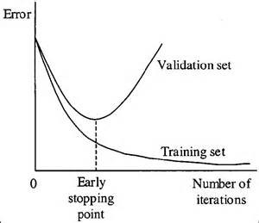
How to Prevent Overfitting?
2. Early Stopping:
Its rules provide us with guidance as to how many iterations can be run before the learner begins to over-fit.

Slide 13
How to Prevent Overfitting?
3. Pruning - Removing the nodes
4. Regularization - selective forget
5. Remove Features
6. Train with more data
7. Ensembling

Slide 14
Hands-On

Slide 15
Final Words on Regularization
Which one to choose ?
Plain Regression (Without Regularization)
L1 Regularization (Lasso)
ElasticNet
L2 Regularization
Not Preferred
Helps in removing unwanted features , but may behave erratically
Next to L2
By default : Best

Slide 16
Ensembling

Slide 17
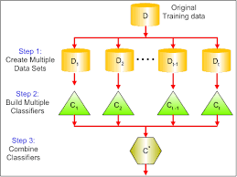
Bagging
Bagging attempts to reduce the chance of overfitting complex models.
It trains a large number of “strong” learners in parallel.
A strong learner is a model that’s relatively unconstrained.
Bagging then combines all the strong learners together in order to “smooth out” their predictions.

Slide 18
Next : Hands - On

Slide 19
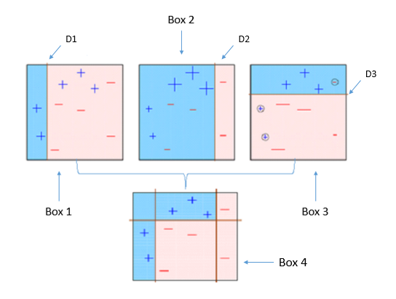
Boosting
Boosting attempts to improve the predictive flexibility of simple models.
It trains a large number of “weak” learners in sequence.
A weak learner is a constrained model (i.e. you could limit the max depth of each decision tree).
Each one in the sequence focuses on learning from the mistakes of the one before it.
Boosting then combines all the weak learners into a single strong learner.

